Slide 1

Insurance Analytics Project
Project Code: P675 | Date: 26/10/2024

Slide 2
Introduction
Project Overview:
This project aims to analyze the insurance industry Data .This presentation provides an analysis of the branch's performance by Account Executives for different income classes. It includes a review of key metrics such as Cross sell, Renew and New, Invoice Details, financial performance and Opportunity by employees of Ahmedabad branch.
Objectives:
Review the performance metrics.
Identify trends and anomalies.
Highlight areas of improvement and success.
Create Dashboard in Excel ,Power BI ,Tableau, SQL query for KPI’S .

Slide 3
Meet Our Team
Ms. Khushi Vishwakarma
Mr. Akash Kumar
Ms. Akumalla Jahnavi
Ms. Mangala Patil
Mr. Shubham Ramesh Uppar
Mr. Harsh Burman
Mentors:
Mr. Mahendra Singh
Ms. Abirami R
Mr. Ashutosh Garg

Slide 4
Agenda
Project Goal & Insurance Analytics Introduction
Dataset Description
Data Schema
KPI Analysis
Dashboard Design
Recommendations
Conclusion & Closure

Slide 5
Dataset Description
The dataset includes critical information for analyzing insurance operations and performance. It consists of:
Brokerage: Information about client policies, including details about income generation and renewal tracking.
Fees: Data about all financial transactions associated with clients, segmented by transaction type and revenue source.
Budget: Detailed insights into resource allocation across branches and employees, covering new initiatives and renewals.
Invoice: A comprehensive record of invoices issued, linking transactions to specific clients for tracking.
Meeting: Logs of meetings managed by account executives, capturing branch associations and participants.
Opportunity: Data on revenue opportunities handled by executives, including risk assessments and progress stages.

Slide 6
KPI Analysis
The project focuses on analyzing key performance indicators to monitor progress and identify actionable insights. These include
Number of invoices generated by each account executive, providing insights into workload distribution and efficiency.
Comparison of targets set versus achievements, highlighting performance gaps or successes.
Tracking the total number of annual meetings to gauge engagement efforts. Identification of the top open opportunities, assessing potential revenue sources and prioritizing them.
Metrics on cross sell, new policies, and renewal rates to measure growth and client retention.

Slide 7
Dashboard Design
Tools Used:
MS Excel
Power BI
Tableau
MY SQL
Features:
Branch performance overview.
Corporate vs. branch metrics.
Insights and action points.

Slide 8
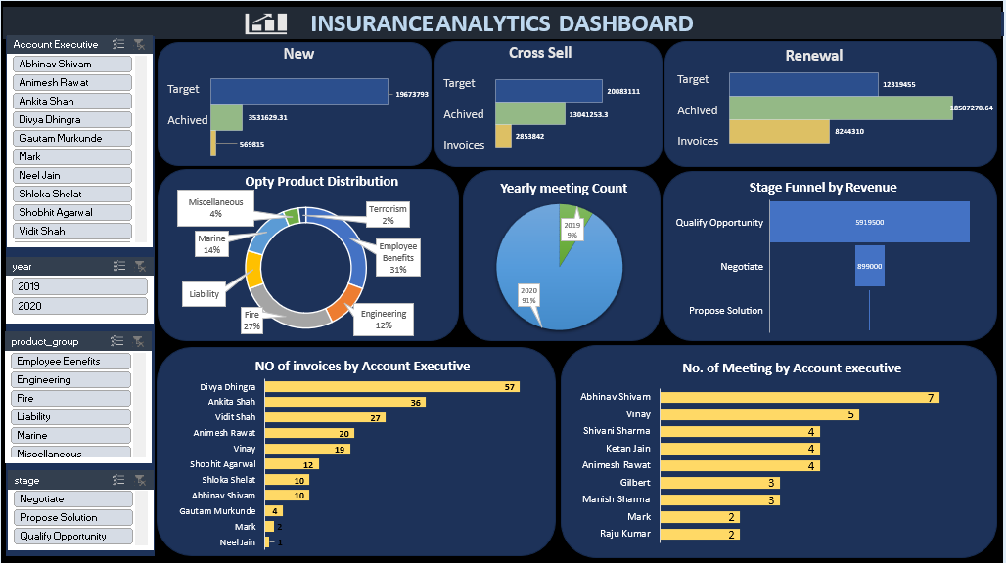
Excel Dashboard

Slide 9
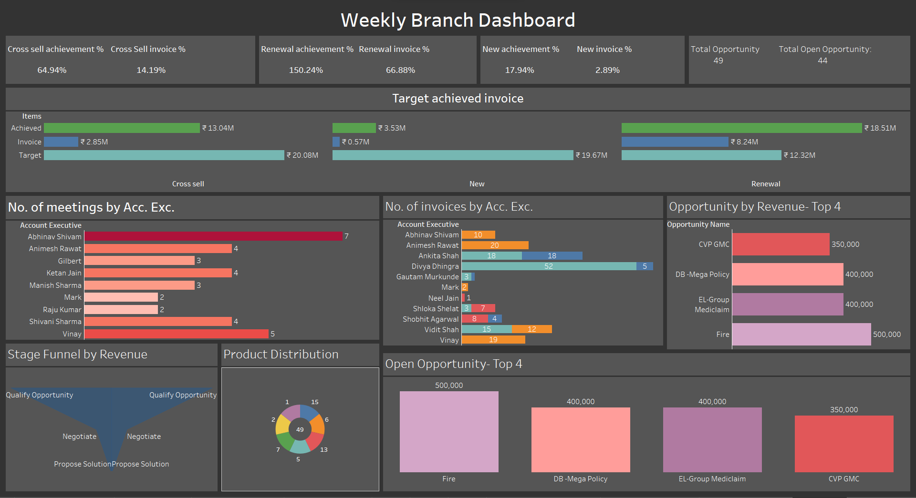
Tableau Dashboard

Slide 10
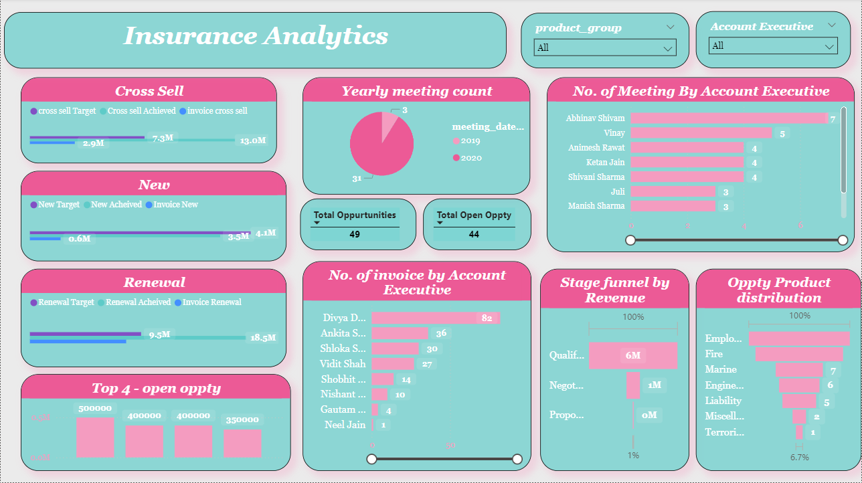
Power BI Dashboard

Slide 11
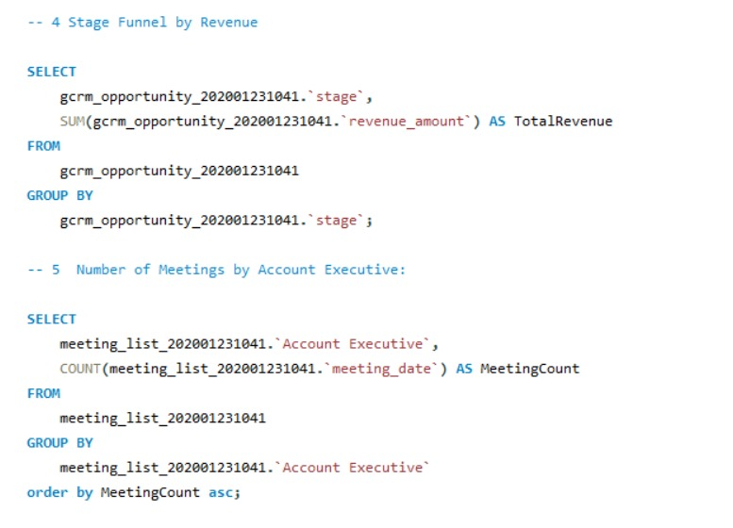
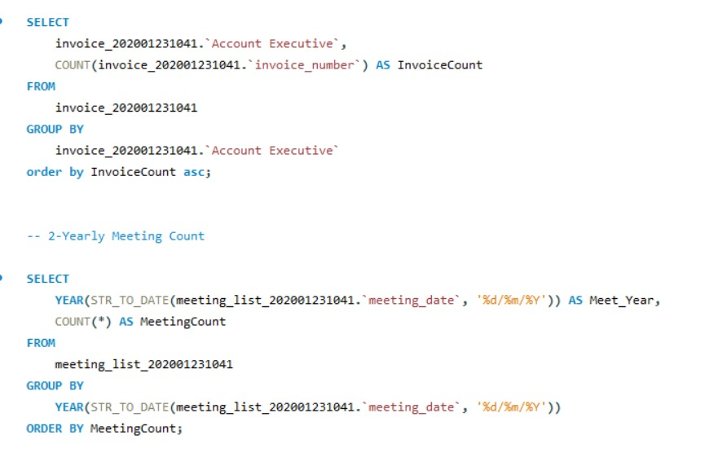
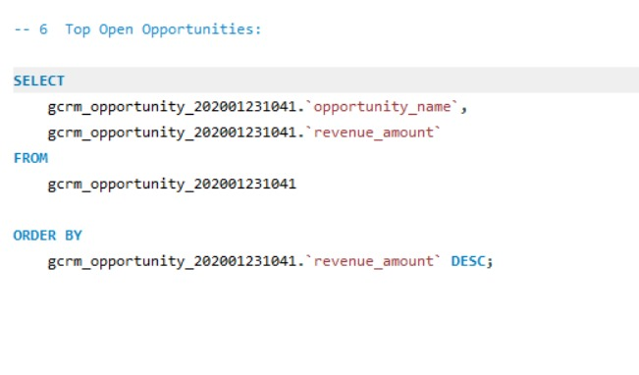
SQL Queries

Slide 12
Recommendations
1. Enhance Customer Service:
AI driven chatbots for 24/7 support.
Staff training on engagement.
2. Expand Product Offerings:
New products for emerging markets.
Bundled insurance packages.
3. Increase Sales and Retention:
Personalized marketing campaigns.
Loyalty rewards for customers.
4. Employee Engagement:
Positive work environment.
Recognition programs.

Slide 13

Conclusion
Steady growth in new policies (Profit Margin: 17.95%).
Exceptional performance in renewals (Profit Margin: 150.23%).
Continue leveraging AI, market research, and employee engagement.

